Slide 1
Data Structure Height Balanced tree
By
Dr. Shubhangi Sapkal

Slide 2
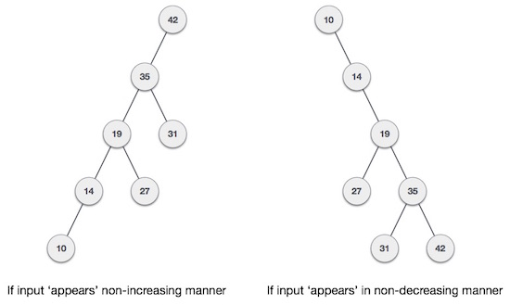
AVL Trees
What if the input to binary search tree comes in a sorted (ascending or descending) manner? It will then look like this −

Slide 3
AVL Trees
It is observed that BST's worst-case performance is closest to linear search algorithms, that is Ο(n). In real-time data, we cannot predict data pattern and their frequencies. So, a need arises to balance out the existing BST.
Named after their inventor Adelson, Velski & Landis, AVL trees are height balancing binary search tree. AVL tree checks the height of the left and the right sub-trees and assures that the difference is not more than 1. This difference is called the Balance Factor.
AVL tree is a self-balancing Binary Search Tree (BST) where the difference between heights of left and right subtrees cannot be more than one for all nodes.

Slide 4
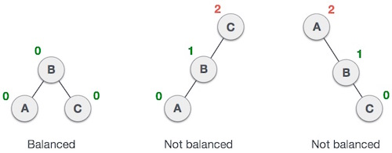
AVL Trees
Here we see that the first tree is balanced and the next two trees are not balanced
In the second tree, the left subtree of C has height 2 and the right subtree has height 0, so the difference is 2.
In the third tree, the right subtree of A has height 2 and the left is missing, so it is 0, and the difference is 2 again. AVL tree permits difference (balance factor) to be only 1.

Slide 5
AVL Rotations
To balance itself, an AVL tree may perform the following four kinds of rotations −
Left rotation
Right rotation
Left-Right rotation
Right-Left rotation
The first two rotations are single rotations and the next two rotations are double rotations. To have an unbalanced tree, we at least need a tree of height 2. With this simple tree, let's understand them one by one.

Slide 6
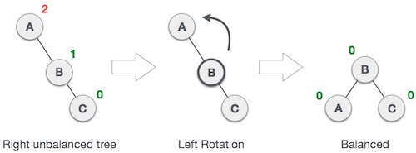
Left Rotation
If a tree becomes unbalanced, when a node is inserted into the right subtree of the right subtree, then we perform a single left rotation −

Slide 7
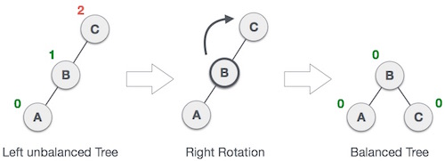
Right Rotation
AVL tree may become unbalanced, if a node is inserted in the left subtree of the left subtree. The tree then needs a right rotation.

Slide 8
Left-Right Rotation
A left-right rotation is a combination of left rotation followed by right rotation.

Slide 9

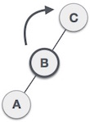
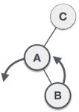
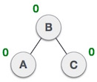
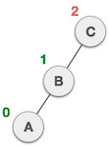
State | Action
 | A node has been inserted into the right subtree of the left subtree. This makes C an unbalanced node. These scenarios cause AVL tree to perform left-right rotation.
 | We first perform the left rotation on the left subtree of C. This makes A, the left subtree of B.
 | Node C is still unbalanced, however now, it is because of the left-subtree of the left-subtree.
 | We shall now right-rotate the tree, making B the new root node of this subtree. C now becomes the right subtree of its own left subtree.
 | The tree is now balanced.

Slide 10
Right-Left Rotation
The second type of double rotation is Right-Left Rotation. It is a combination of right rotation followed by left rotation.

Slide 11

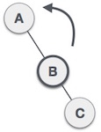
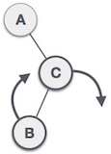
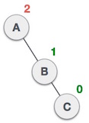
State | Action
 | A node has been inserted into the left subtree of the right subtree. This makes A, an unbalanced node with balance factor 2.
 | First, we perform the right rotation along C node, making C the right subtree of its own left subtree B. Now, B becomes the right subtree of A.
 | Node A is still unbalanced because of the right subtree of its right subtree and requires a left rotation.
 | A left rotation is performed by making B the new root node of the subtree. A becomes the left subtree of its right subtree B.
 | The tree is now balanced.

